Slide 1


Discovering the Charms of Pune: A Comprehensive Guide to an
E ceptional Tourism Website

Slide 2
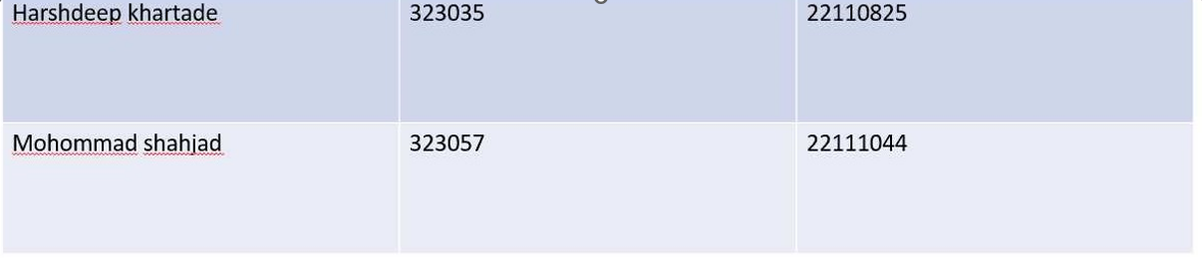

Slide 3
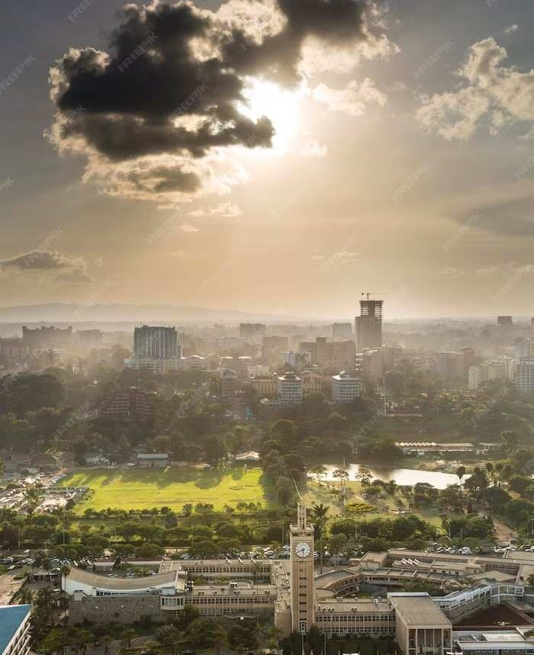
Introduction
Welcome to Discovering the Charms of Pune, a comprehensive guide to an exceptional tourism website. This presentation will provide an insightful overview of the unique attractions and experiences that Pune has to offer. Join us as we explore the hidden gems and cultural landmarks that make Pune a must-visit destination for travelers.

Slide 4
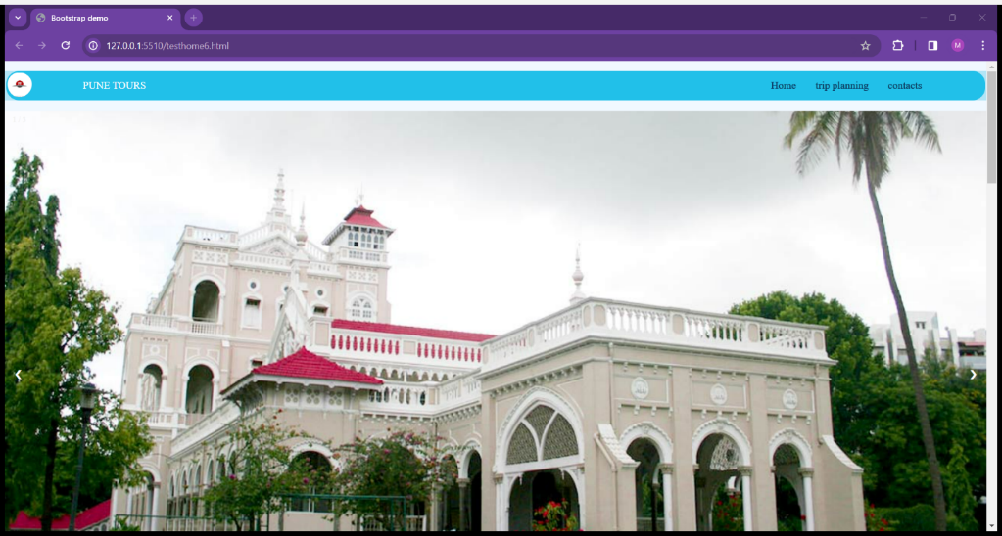
Homepage:
homepage include Google Map Api , navbar and a large carousal with some information about the Aga Khan Palace , Shaniwar Wada and Lonavala pics
Where Home opens to food,festivals and places to visit , trip planning opens to form for submission and contacts page is just farewell page for the website

Slide 5
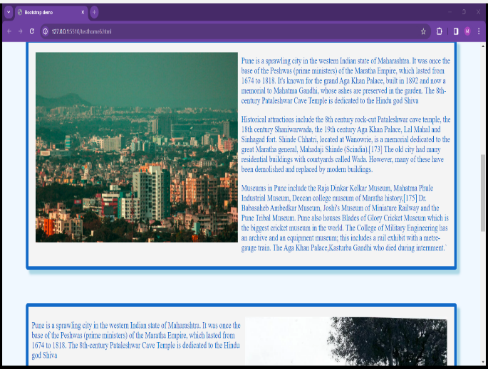
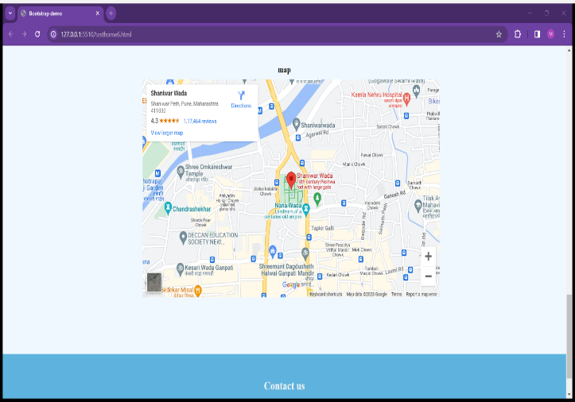
Info about the city like its historical significance also used the css effects such as zoom to make it look attractive and the Google map Api using javascript for location such as Shaniwar wada many locations of the Pune city which are of Much interest for the tourist people

Slide 6
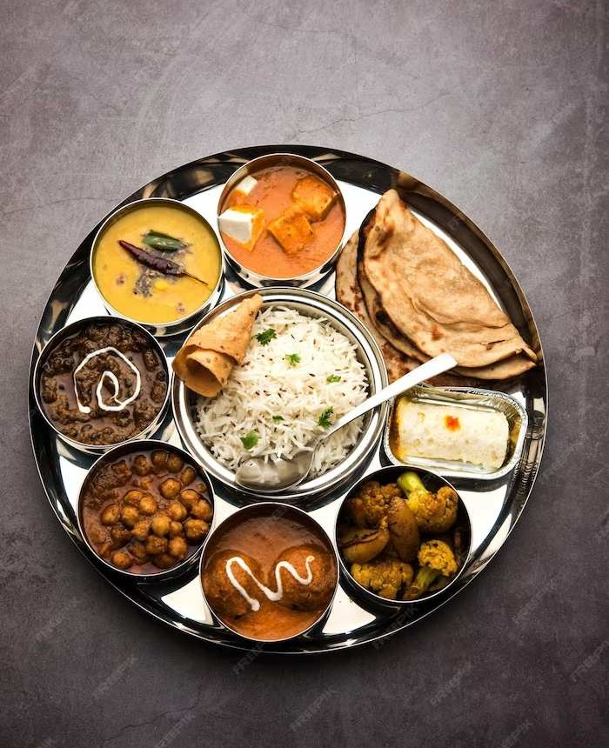
Culinary Delights
Indulge in the as we explore the citﬂavors of Pune y’s diverse culinary scene. From traditional Maharashtrian delicacies to global fusion cuisine, Pune offers a gastronomic adventure for food enthusiasts. Uncover the hidden gems of Pune’s food culture and savor the unique culinary delights that deﬁne the city’s vibrant food scene.

Slide 7
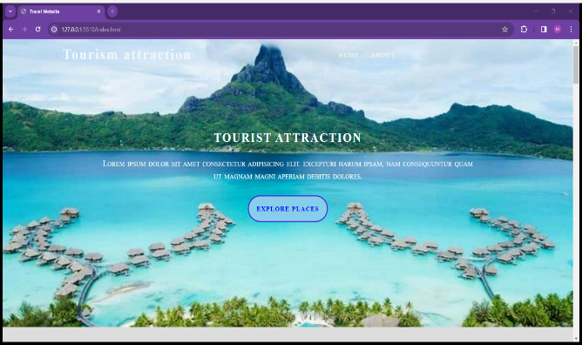
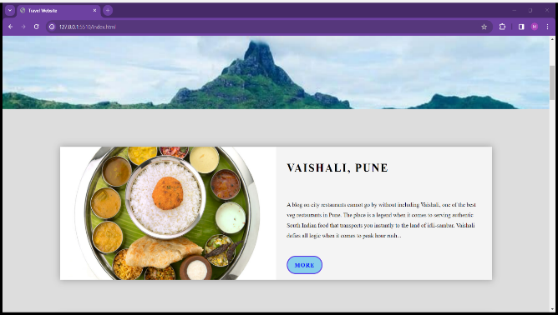
Food Page:
food page(index.html)-----Harsh deep katharde
this include a fixed image and a multiple set of image and info card with ending footer with the social media contacts about Instagram ,Facebook etc.also ther are mentions of the many famous restaurants and also local food is promoted which have the part of the

Slide 8
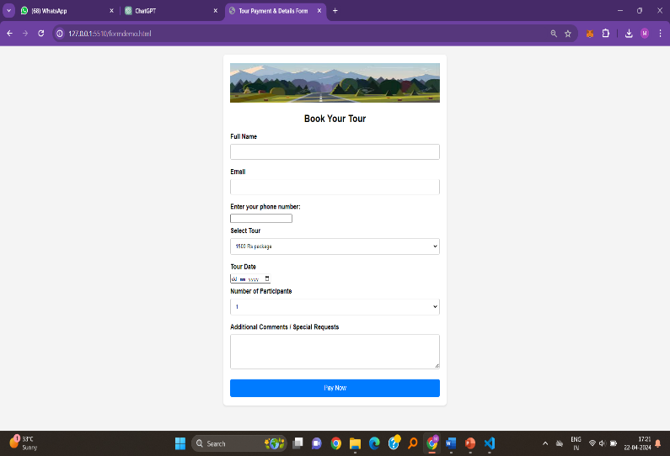
Contact form:
trip planning(form1.html
this include the input and entry set for the form and various details of the work are shown here , also used the react and NodeJS where used the razor pay to pay the payment related to the tours and NodeJS stores the results using the MongoDB , where in the compass you can see the transactions

Slide 9
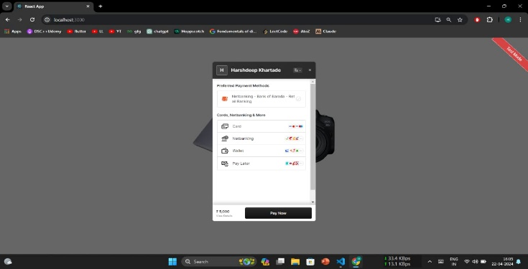
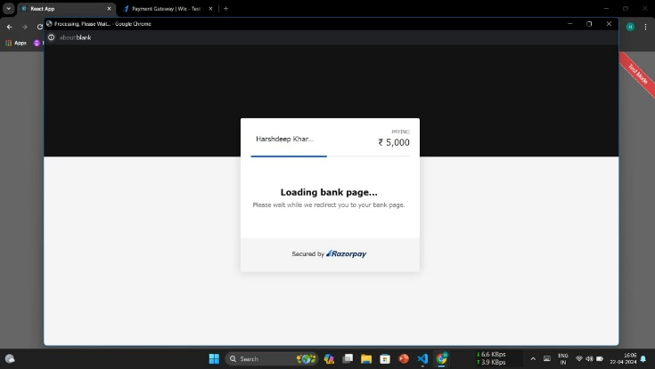
Payment portal after we select the package of tour we and after we click the pay button on the trip planning form then we select the type f payment , which in this we have selected the credit card then second image is of the payment in process the window is displayed ,displaying messages “Loading bank page”

Slide 10
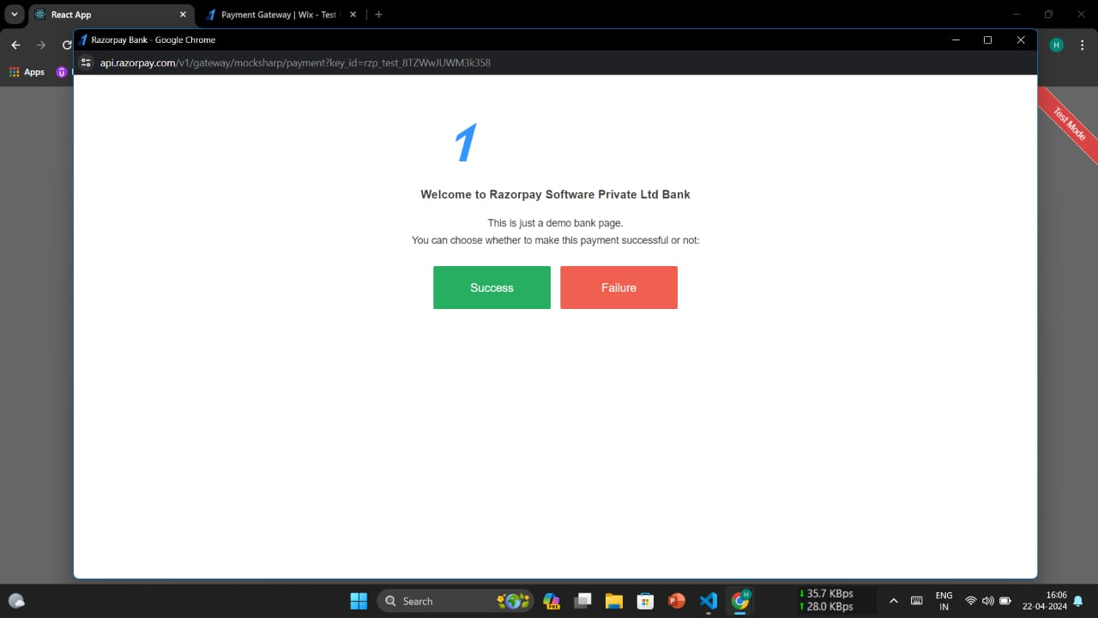
This page displayed that ,the payment gateway is in testmode , so we can deliberately make success the payment and fail the payment , so this is its image

Slide 11
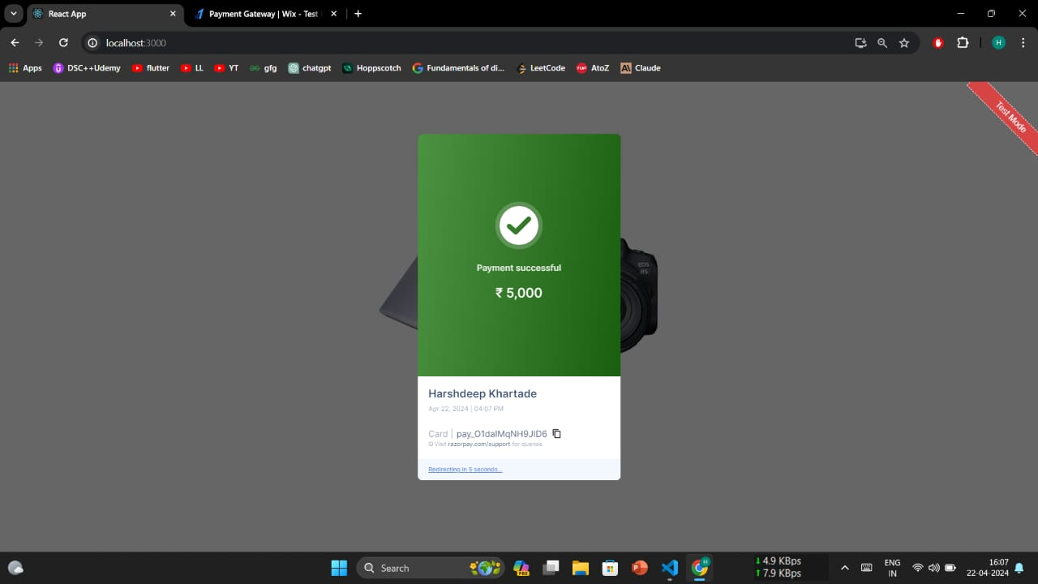
This the page after we have successfully made the payment through the Razorpay X ,the test payment of 5000 rupees with its payment id

Slide 12
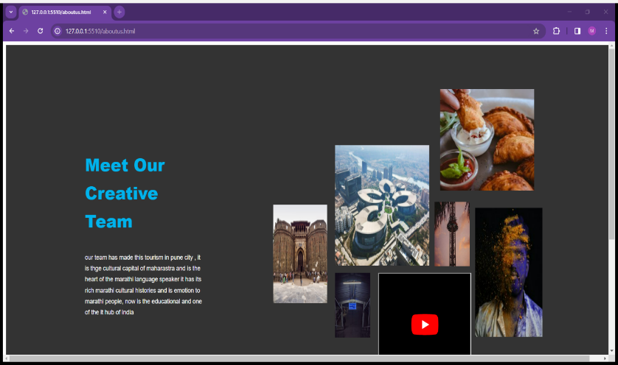
Just a Thanksgiving Page by Mohommad Shahjad written Farewell

Slide 13
Conclusion
Thank you for joining us on this insightful journey through the charms of Pune. We hope this comprehensive guide has provided valuable insights and inspiration for your exploration of Pune’s exceptional tourism offerings. Whether you’re a ﬁrst-time visitor or a seasoned traveler, Pune’s diverse attractions and experiences await your discovery.

Slide 14
Thanks!

